Slide 1

VIETNAM NATIONAL UNIVERSITY HO CHI MINH CITY
HO CHI MINH CITY UNIVERSITY OF TECHNOLOGY
FACULTY OF COMPUTER SCIENCE AND ENGINEERING
LOGIC DESIGN PROJECT REPORT
SIMPLE PROCESSOR ON BOARD DE2i-150
Major: Computer Engineering
Council | LOGIC DESIGN PROJECT COMMITTEE 5
Instructor | Nguyen Tran Huu Nguyen
Secretary | Pham Hoang Anh
Reviewer | Nguyen Cao Tri
Student | Huynh Trung Nhat Do Huu Thanh Thien | 2053294 2053250

Slide 2


Ho Chi Minh City University of Technology Faculty of Computer Science and Engineering
INTRODUCTION
Tools and Materials
Intel Quartus Prime Design Software
Verilog HDL
Overleaf Online Latex Editor

Slide 3
Ho Chi Minh City University of Technology Faculty of Computer Science and Engineering
Content of project
Basic knowledge
Advance knowledge
Lab 1
Switches, Lights, and Multiplexers
Lab 7
Finite State Machines
Lab 2
Numbers and Displays
Lab 8
Memory Blocks
Lab 3
Latches, Flip-Flops, and Registers
Lab 9
A Simple Processor
Lab 4
Counters
Lab 10
An Enhanced Processor
Lab 5
Timers and Real-Time Clocks
Lab 11
Implement Algorithms in Hardware
Lab 6
Adders, Subtractors, and Multipliers
Lab 12
Digital Signal Processing (Optional)

Slide 4
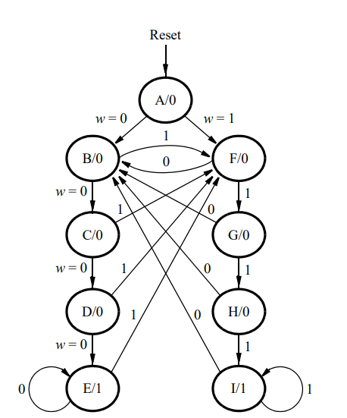
Ho Chi Minh City University of Technology Faculty of Computer Science and Engineering
Labotary Exercise 7
Part II: FSM According to a State Diagram
Finite State Machines
Using Flip Flop to implement FSM
A, B, C, D, E, F, G are the state of the FSM
At each state, we check the condition corresponding with that state to set the next state of the system

Slide 5
Ho Chi Minh City University of Technology Faculty of Computer Science and Engineering
Labotary Exercise 7
Detail Explanation
if current_state = B then
if (input = 0) then
next_state = C
else next_state = F
FLIP
FLOP
next_state
current_state
CLOCK

Slide 6
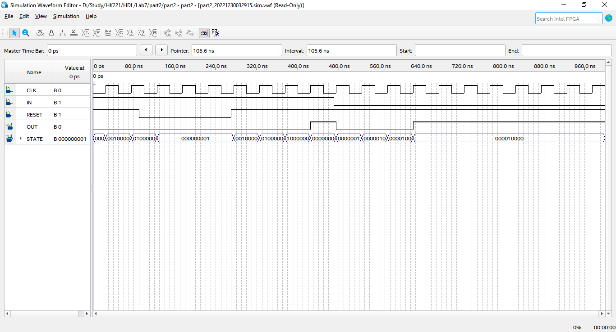
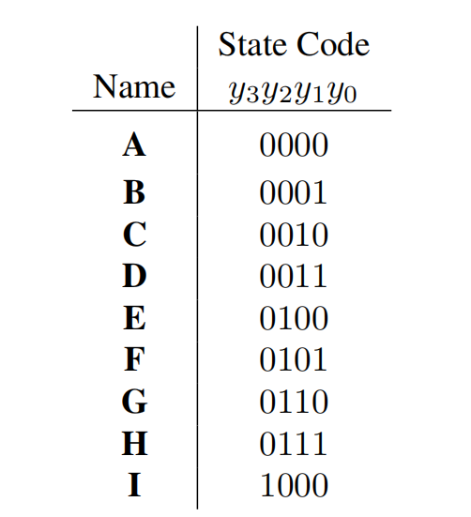
Ho Chi Minh City University of Technology Faculty of Computer Science and Engineering
[0]
current_state = A && input = 1
→ next_state = F
current_state = F && input = 1
→next_state = G
If (posedge CLK)then
current_state <= next_state
→current_state = F
[1]
[2]
[3]
[4]
[5]
[6]
[7]
[8]

Slide 7
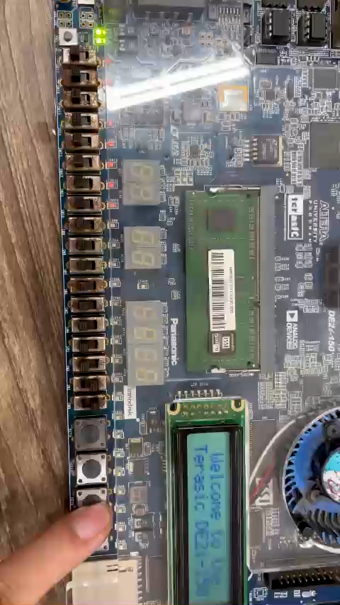

Slide 8
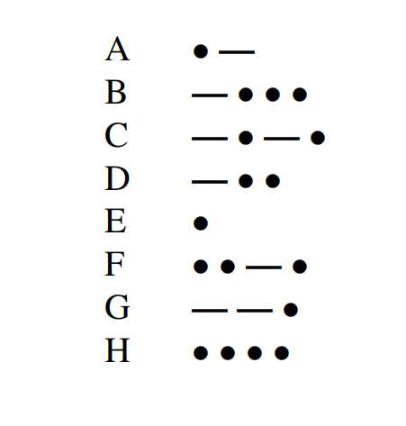
Ho Chi Minh City University of Technology Faculty of Computer Science and Engineering
Labotary Exercise 7
[0] = 3’b000
Finite State Machines
[1] = 3’b001
[2] = 3’b010
Part IV: Encode input to Morse code
[3] = 3’b011
[4] = 3’b100
Translate the Alphabet in to binary code
[5] = 3’b101
HINT 0.5 - second pulse represent dots
1.5 - second pulse represent dashs
[6] = 3’b110
[7] = 3’b111
0.5 second
1.5 second

Slide 9
Ho Chi Minh City University of Technology Faculty of Computer Science and Engineering
0.5 second
1.5 second
➔ 14’b00[1]0[111]0000000
➔ 14'b00111010101000
➔ 14'b00111010111010
➔ 14'b00111010100000
➔ 14'b00100000000000
➔ 14'b00101011101000
➔ 14'b00111011101000
➔ 14'b00101010100000

Slide 10
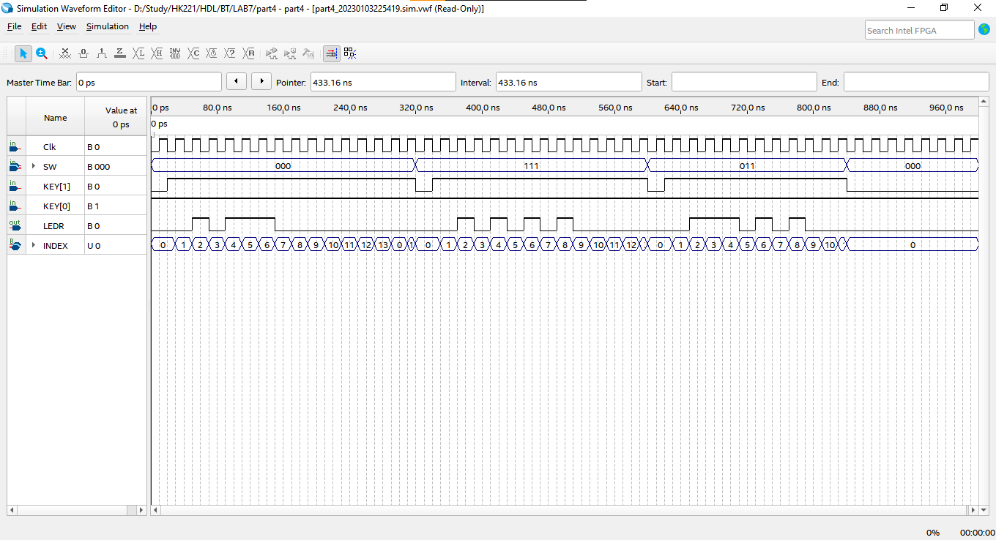
index = 1 → LEDR = signal[13-1] = 0
index = 3 → LEDR = signal[13-3] = 0 (end of dot)
index = 4 → LEDR = signal[13-4] = 0 (begin of dash)
index = 7 → LEDR = signal[13-7] = 0 (end of dash)
index = 2 → LEDR = signal[13-2] = 1 (start of dot)
start_signal = 1 → load input
[0] = 3’b000 ➔ signal = 14'b00101110000000
If (posedge CLK) then increase index by 1
➔ LEDR = signal[13-index]

Slide 11
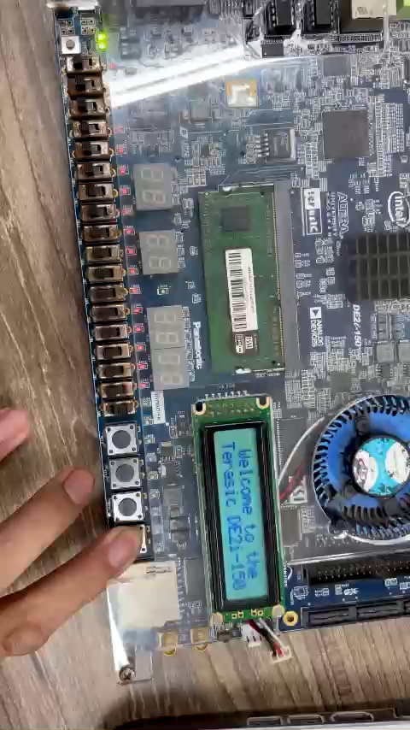

Slide 12
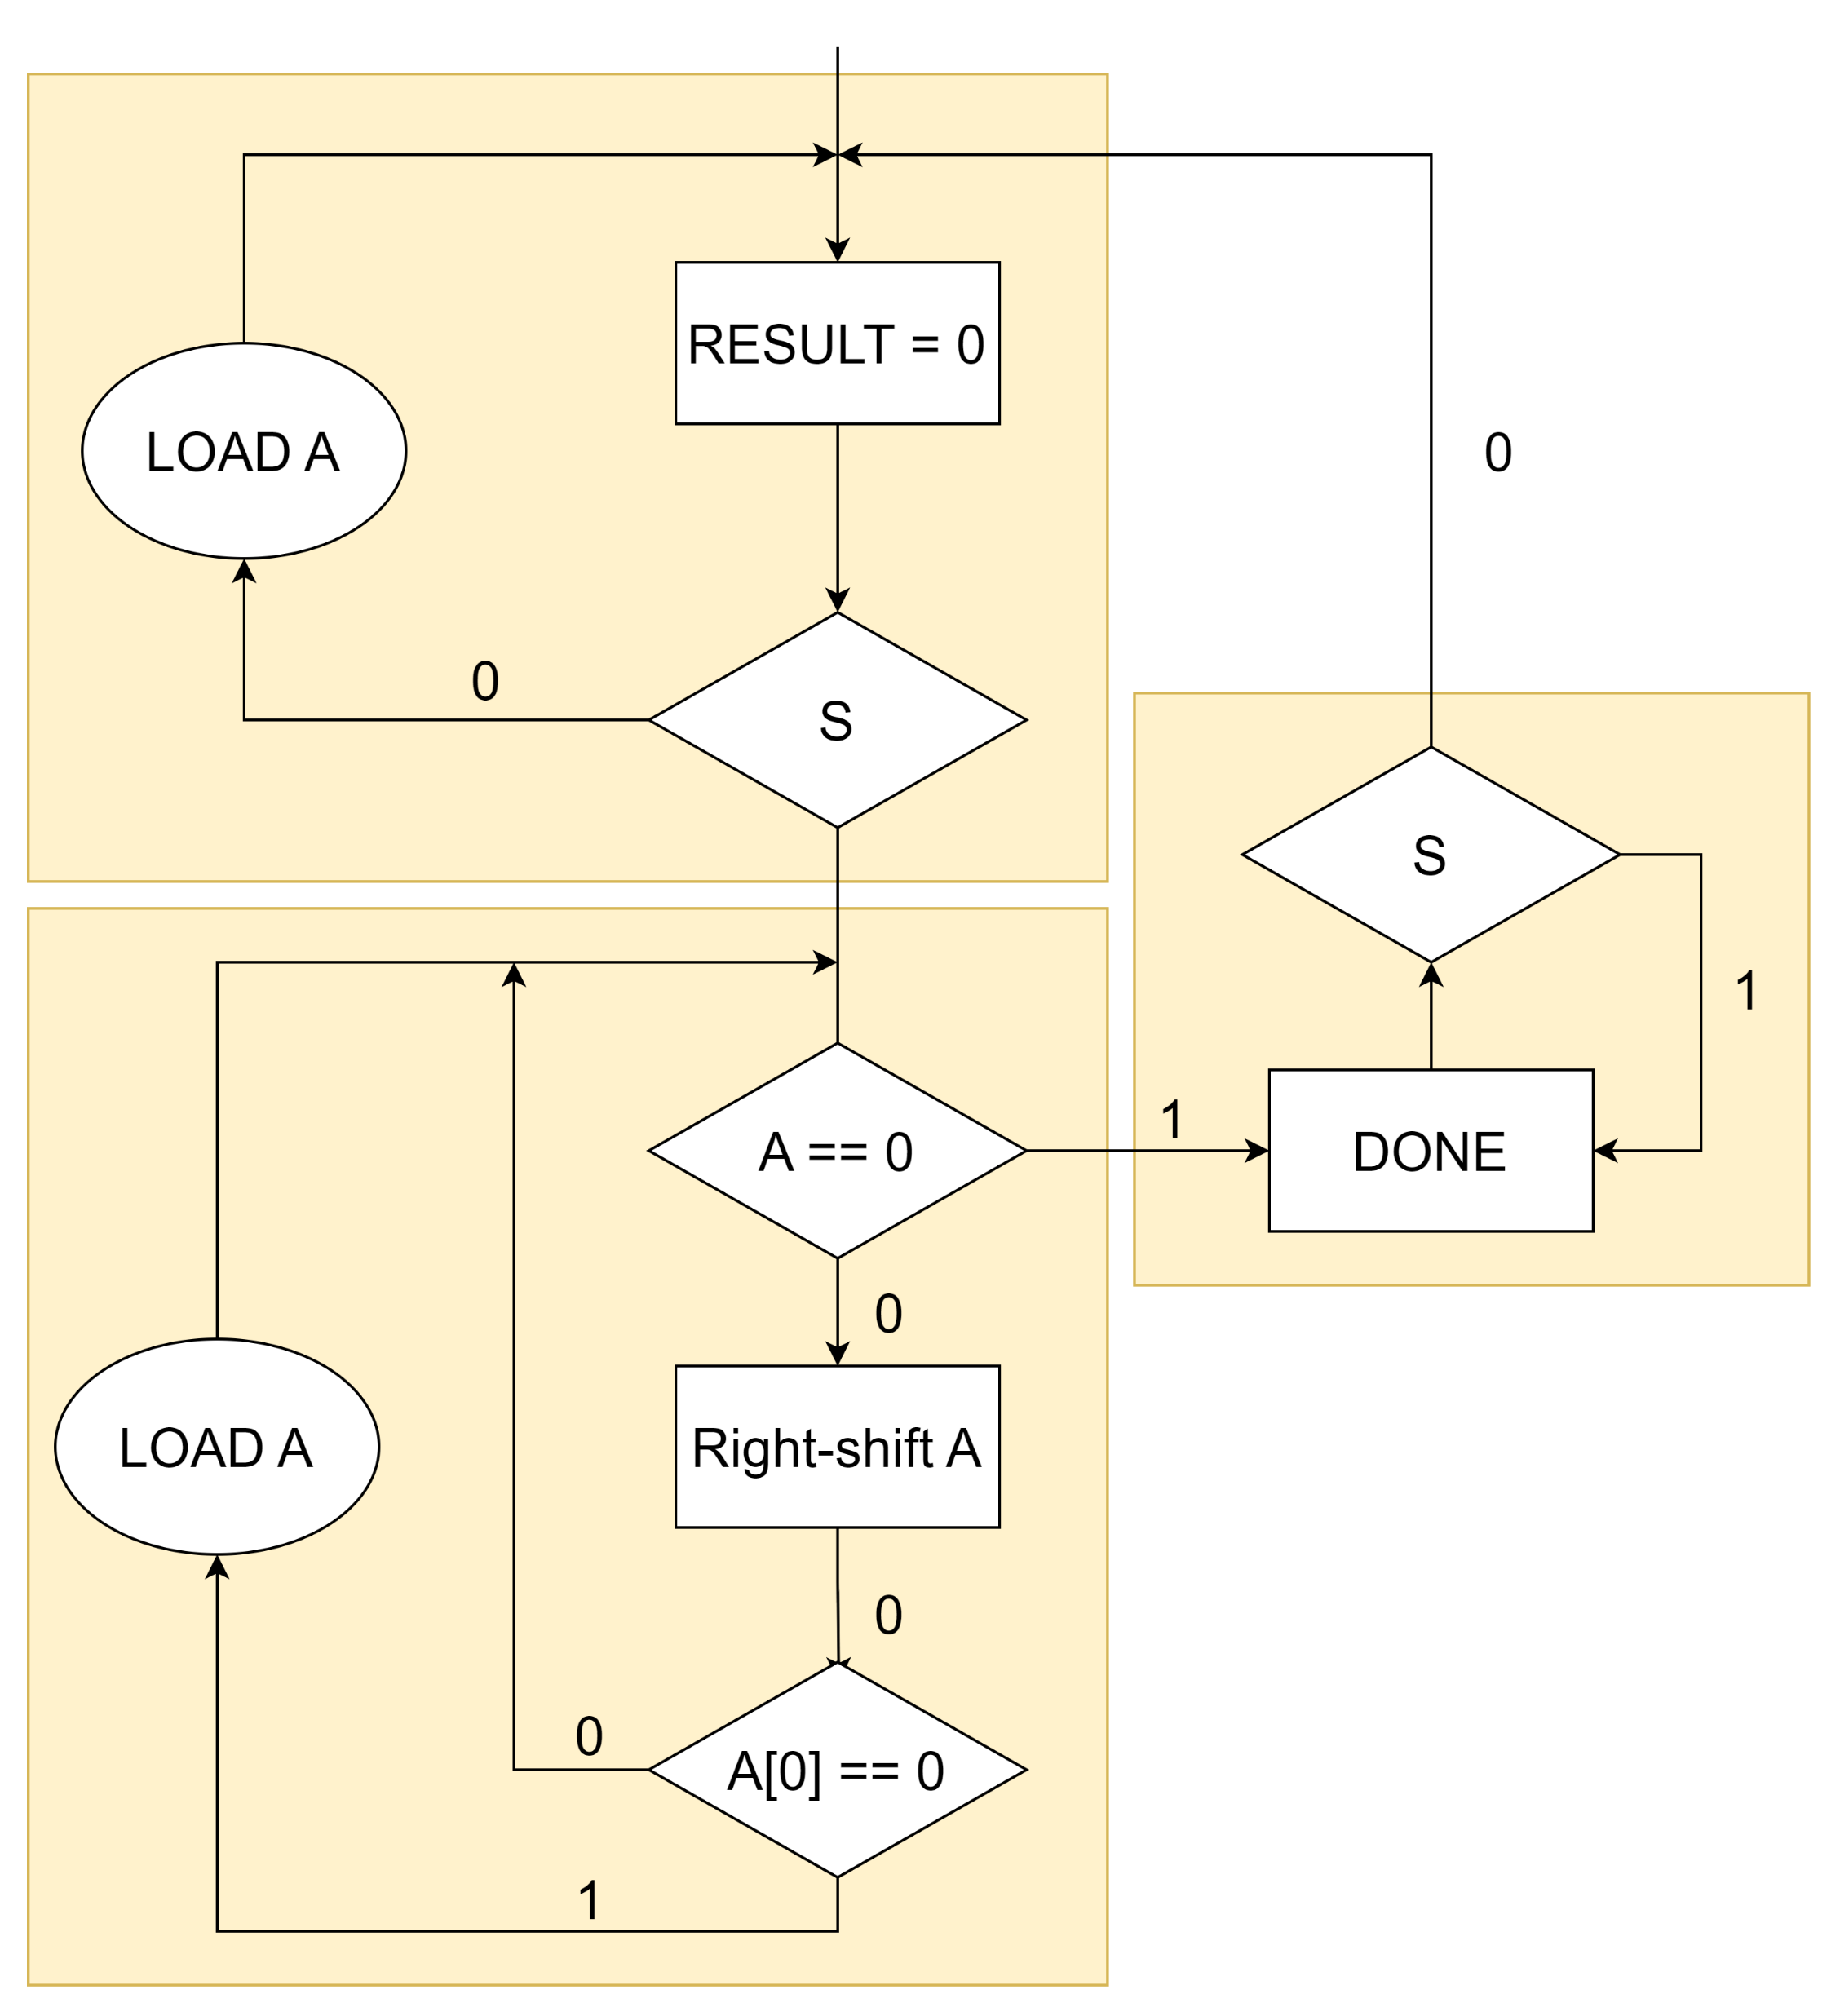
Ho Chi Minh City University of Technology Faculty of Computer Science and Engineering
S1
Labotary Exercise 11
Part I: ASM for the bit-counting circuit
S3
S3
Agorithmic State Machine looks just like regular flow charts
S2
Algorithm State Machines
The different: implied timing
All action in a state just happen when a clock occurs

Slide 13
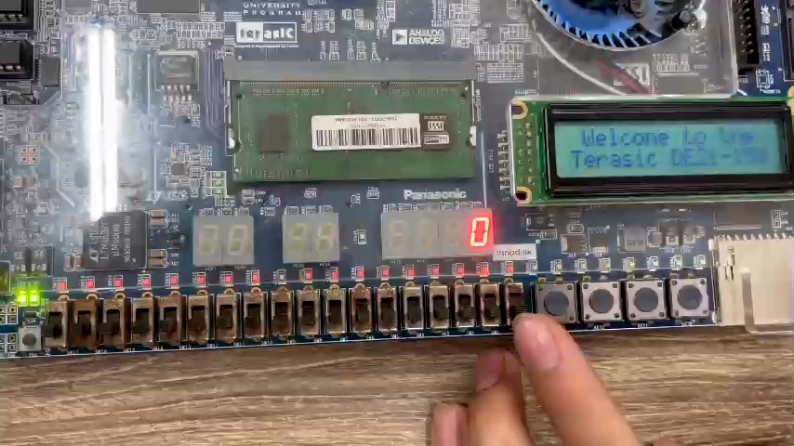

Slide 14
Ho Chi Minh City University of Technology Faculty of Computer Science and Engineering
Labotary Exercise 11
function Binary_Search(A, n, T)
L := 0
R := n - 1
while L ⩽ R do
m := (L + R) / 2
if A[m] < T then
L := m + 1
else if A[m] > T then
R := m - 1
else return m
return unsuccessful
Algorithm State Machines
Part II: Binary search algorithm
Using memory on chip to store sorted array
State: INIT, BEGIN, WAIT, FIND, DONE

Slide 15
LEFT = 0
RIGHT = 0
ADDRESS = 0
DONE = 0
FOUND = 0
FIND
INIT
LEFT = ADDRESS +1
RIGHT = ADDRESS -1
start
LEFT >= RIGHT
LEFT >= RIGHT
DONE = 1
FOUND = 0
ADDRESS =
(LEFT + RIGHT)/2
BEGIN
Data > value
Data < value
DONE
Value =
RAM[ADDRESS]
DONE = 1
FOUND = 1
WAIT
OUTPUT =
ADDRESS
DONE

Slide 16
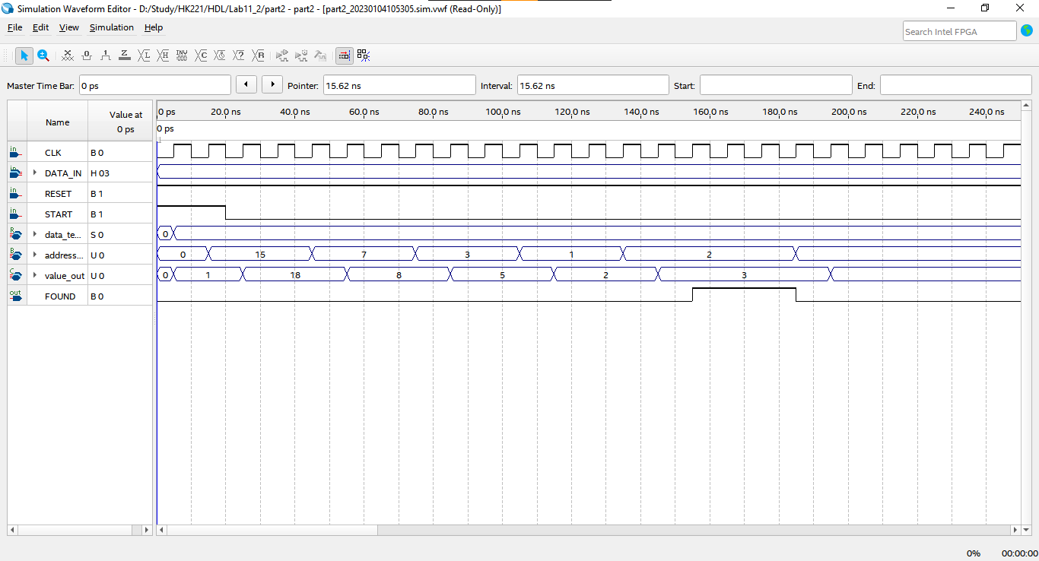
FIND: loaded data = input
→ DONE = 1, FOUND = 1
&& change state to WAIT
BEGIN: calculate then ADDRESS
&& change state to WAIT
INIT && START = 1 → state change from INIT to BEGIN
BEGIN: calculate then ADDRESS
&& change state to WAIT
WAIT: Load data in RAM at ADDRESS
&& change state to FIND
FIND: Compare loaded data with input
&& change state to BEGIN

Slide 17
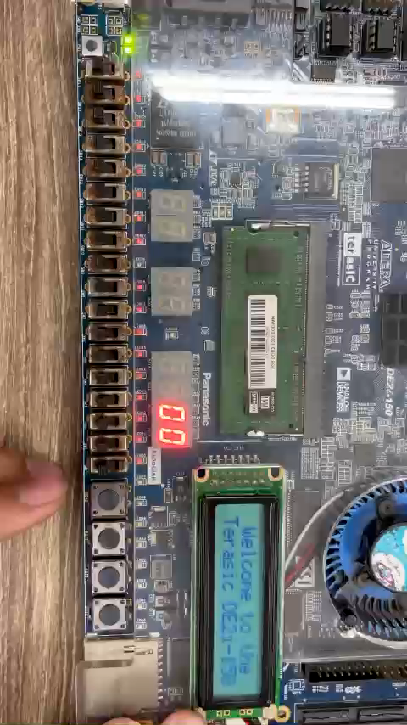

Slide 18
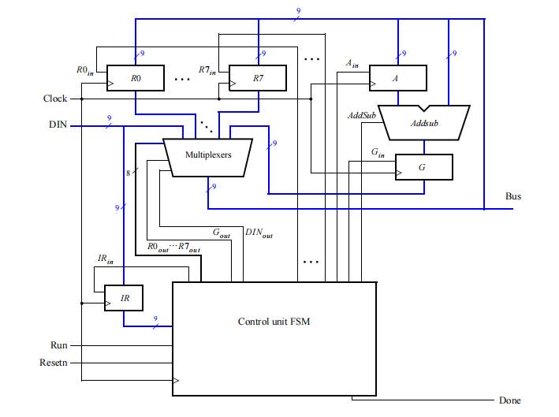
Ho Chi Minh City University of Technology Faculty of Computer Science and Engineering
Labotary Exercise 9
Part I, II
Build a simple processor using registers, a multiplexer, an adder and subtractor unit, and a control unit.
A Simple Processor
Study how instructions are encoded and used to control the processor.

Slide 19
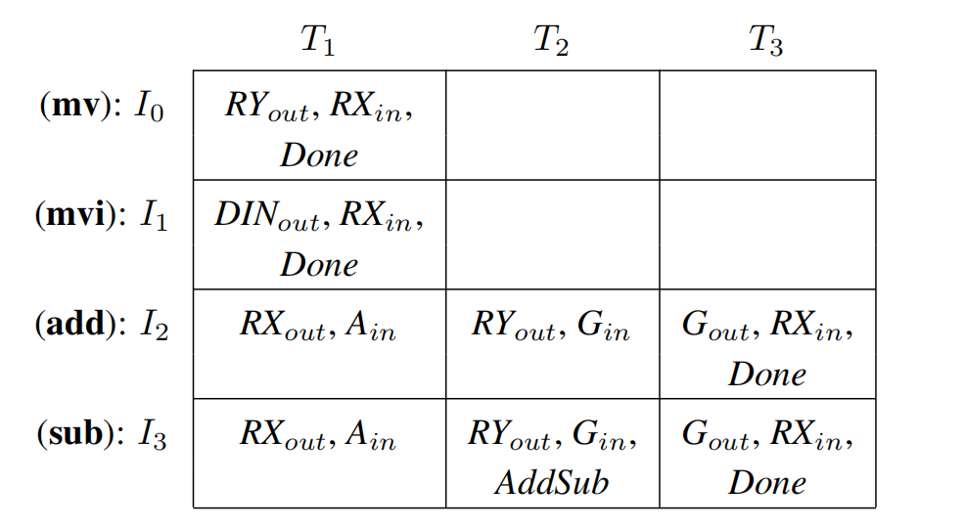
Ho Chi Minh City University of Technology Faculty of Computer Science and Engineering

Slide 20
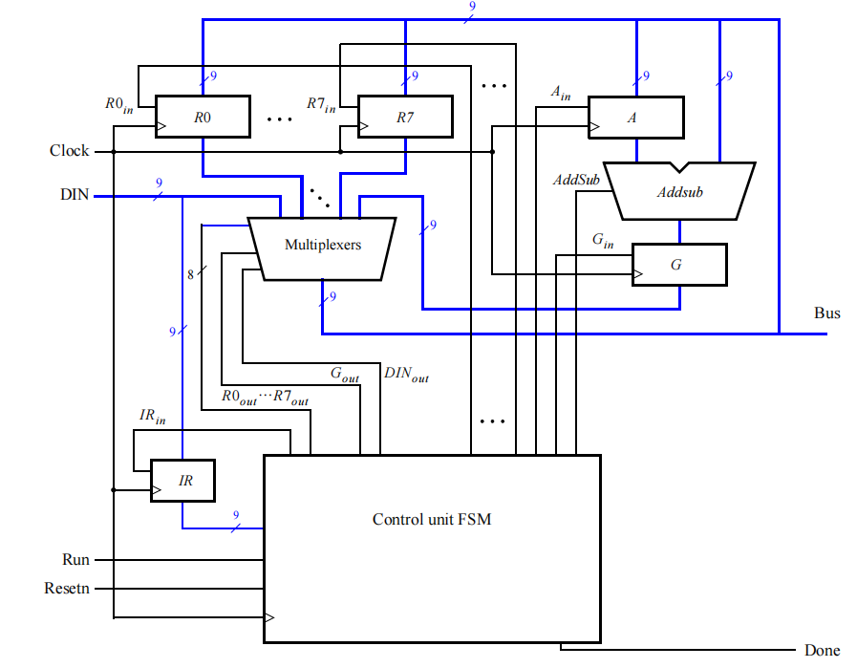
MEMORY UNIT
COMPUTING UNIT
SELECT UNIT
CONTROL UNIT

Slide 21
MEMORY UNIT
Data flow
Control signal
COMPUTING UNIT
SELECT UNIT
CONTROL UNIT
Instruction/ data in
START

Slide 22
010
Register 0
Register 1
010
010
COMPUTING UNIT
SELECT UNIT
010
CONTROL UNIT
mv R0, R1
START

Slide 23
030
Register 0
Register 1
010
010
COMPUTING UNIT
030
SELECT UNIT
030
CONTROL UNIT
030
mvi R0
START

Slide 24
040
010
030
Register 0
030
Register 1
010
010
COMPUTING UNIT
SELECT UNIT
040
010
040
030
CONTROL UNIT
add R0, R1
START

Slide 25
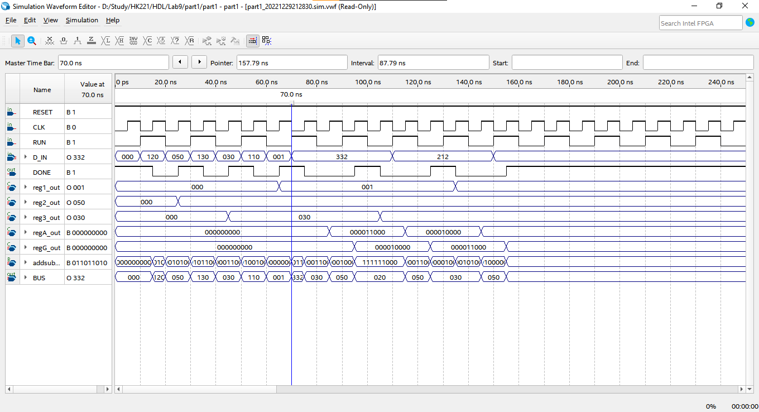
After 3 clock pulse → DONE = 1
Load instruction (130 → mvi r3)
→DONE = 1
load instruction 332 → sub R3,R2
→ DONE = 0
load value 050 into register 2
Load instruction (120 → mvi r2)
→DONE = 1
load value 030 into register 3

Slide 26
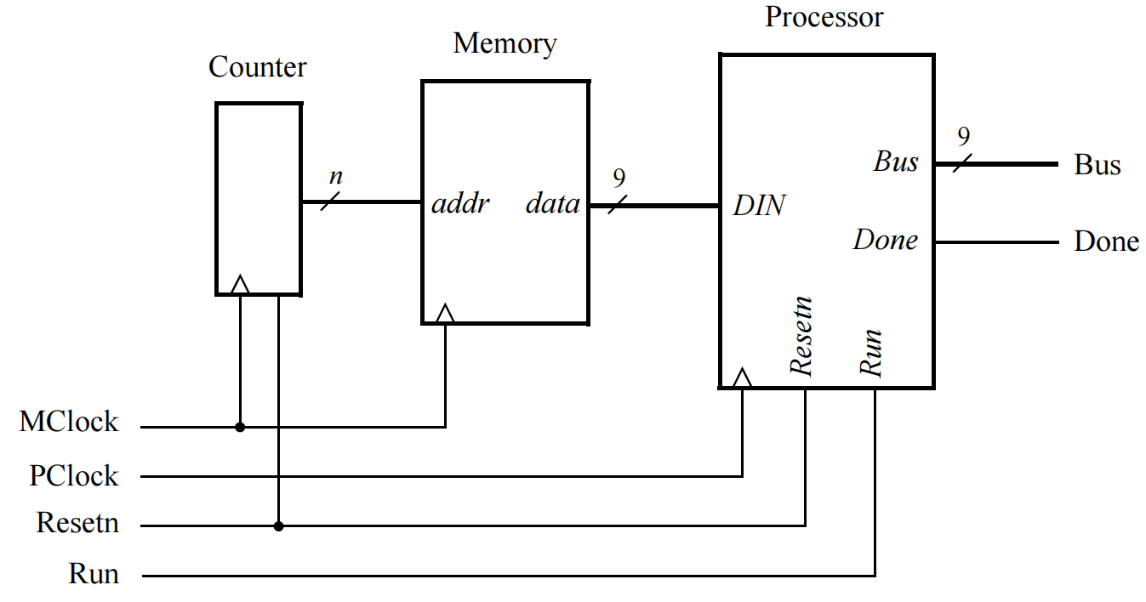
Ho Chi Minh City University of Technology Faculty of Computer Science and Engineering
Labotary Exercise 9
Part II: Connect processor to memory
INSTRUCTION in Memory
100: mvi R0;
005: load data;
010: mv R0, R1;
201: add R0, R1;
300: sub R0, R0;
[5..31] : 000;
END;

Slide 27
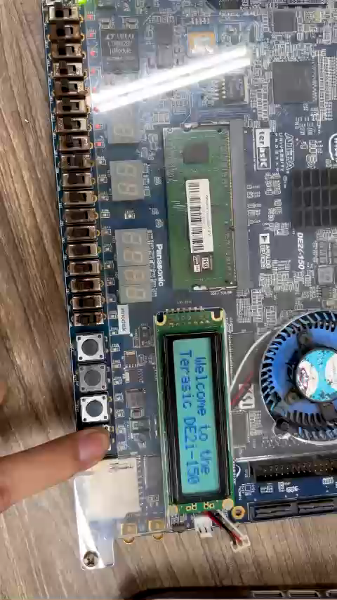
INSTRUCTION in Memory
100: mvi R0;
005: load data;
010: mv R0, R1;
201: add R0, R1;
300: sub R0, R0;
[5..31] : 000;
END;

Slide 28
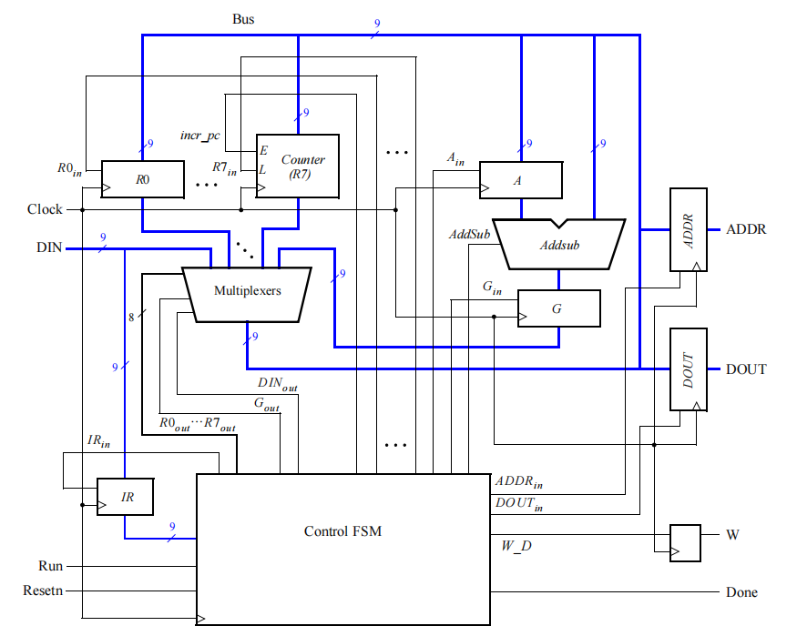
Ho Chi Minh City University of Technology Faculty of Computer Science and Engineering
External
counter
Internal
counter
Read Only
Memory
Random Access
Memory
Labotary Exercise 10
Part III: Enhance Processor
Add functionality so that your processor can perform read and write operations using memory or other devices
Enhance Processor
Study how instructions are encoded and used to control the processor.

Slide 29
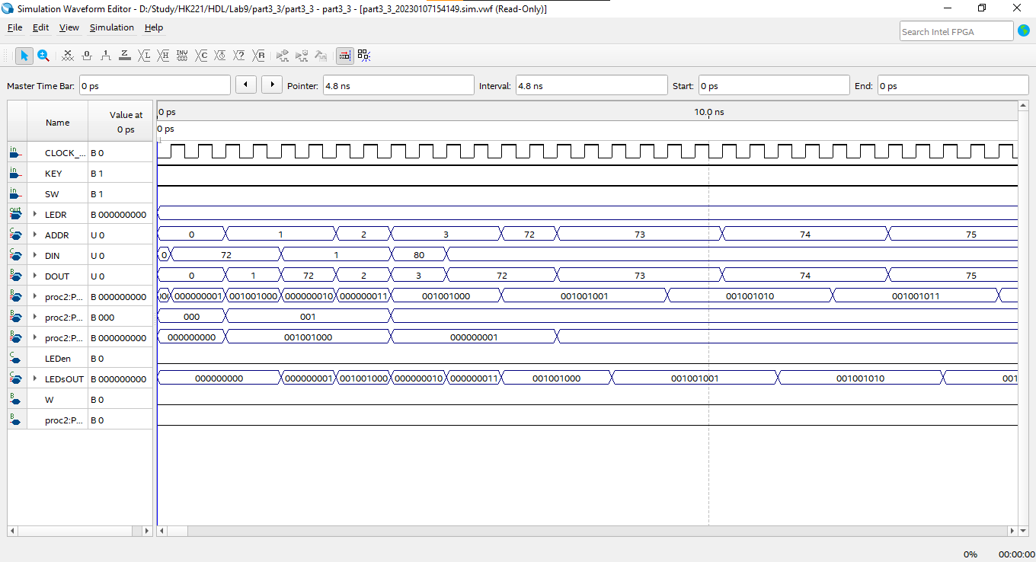
Right Address to read
Unpredictable Value

Slide 30
LOGIC DESIGN PROJECT REPORT
SIMPLE PROCESSOR ON BOARD DE2i-150
Major: Computer Engineering
THANK YOU

